Slide 1

Version Control
Version control is a system that records changes to a file or set of files over time so that you can recall specific versions later.
If you are a graphic or web designer and want to keep every version of an image or layout then it allows you to revert files back to previous state revert the entire project back to previous state, compare changes over time, see who last modified something that might be causing a problem , who introduce an issue and when, and more.

Slide 2
Why Is Version Control So Important?
Keeping track of changes.
Ability to go back to a previous working version.
Easily add someone else’s work.

Slide 3
Types of version control system
Centralized Version Control System
Distributed Version Control System

Slide 4
VCS
Centralized Version control system
Centralized version control means that the version history is stored in a central server. When a developer wants to make changes to certain files, they pull files from that central server to their own computer. After the developer has made changes, they send the changed files back to the central server.
Distributed Version control system
Distributed VCS, everyone has a local copy of the entire work’s history This means that it is not necessary to be online to change revisions or add changes to the work.
“Distributed” comes from the fact that there isn’t a central entity in charge of the work’s history, so that anyone can sync with any other team member. This helps avoid failure due to crash of the central versioning server.

Slide 5
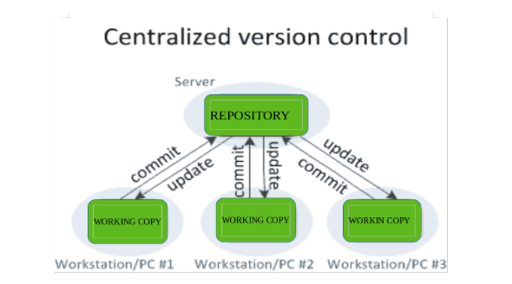

Slide 6
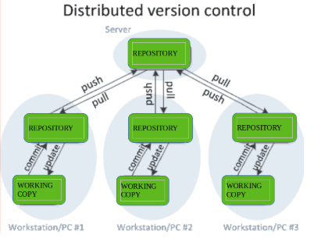

Slide 7
SVN
SVN is a centralized version control system. ... Centralized version control means that the version history is stored in a central server. When a developer wants to make changes to certain files, they pull files from that central server to their own computer

Slide 8

Introduction to GIT
Git is a distributed version-control system for tracking changes in source code during software development.
It is designed for coordinating work among programmers, but it can be used to track changes in any set of files.
Its goals include speed, data integrity and support for distributed, non-linear workflows.
Git is free and open-source software distributed under the terms of the GNU General Public Licensee version 2.

Slide 9
Installation Of GIT
Installation Git on Windows
Download the git software from the following link.
https://git-scm.com/downloads
2. Now open the software, click next, and customize your installation and finish it.
3. Check the git version from command prompt on your system by executing the following command.
git --version // or you can type the same command by opening git bash
Execute the below command for creating an empty Git repository or reinitialize an existing one.
git init

Slide 10
Installation Git on Linux
Install the git package by running the below command.
yum install git -y
Check the git version by executing the below command from your linux instance.
git --version
4. Execute the below command for creating an empty Git repository or reinitialize an existing one.
git init
5. Configure your Git username and email using the following commands.
git config --global user.name “John”
git config --global user.email john.18@example.com
git config --list

